Slide 1
WELCOME TO THE PRESENTATION

Slide 2

Project PRESENTATION ON C#.Net Student information
PRESENTED BY
Mohammad Ashraful Islam ; ID: 15162103013 ; SEC: 01 ; INTAKE: 32ND
SK. Tanvir Rahman ; ID: 15162103041 ; SEC: 01 ; INTAKE: 32ND
Razowana Khan Shatu ; ID: 15162103037 ; SEC: 01 ; INTAKE: 32ND
DEPARTMENT OF B.Sc. in CSE
FACULTY OF ENGINEERING & APPLIED SCIENCES
BANGLADESH UNIVERSITY OF BUSINESS AND TECHNOLOGY

Slide 3
index
INTRODUCTION
OBJECTIVE
HARDWARE & SOFTWARE REQUIREMENTS
FUNCTIONALITIES
WORKING PROCEDURE

Slide 4
INTRODUCTION
The project “Student Information a C# .Net Project.
It is designed to deal with all kinds of student details such as university information, courses, address, phone number etc.
All students details can be tracked through this system.

Slide 5
objective
Manage the details of student, logins, courses, address & phone no etc.
It manages all the information about student profiles.
The project is totally built at administrative end.

Slide 6
Hardware & software requirements
Hardware Requirements:
Processor : Intel® Core™ i5 CPU M460 @ 2.53GHz 2.53GHz
RAM : 4 GB or More
Hard disk : 80GB or More

Slide 7
Continue….
Software Requirements:
Front End : XML
Back End : JAVA
Operation System : Windows 7 or Windows 8 or Windows 10

Slide 8
functionalities
Provides the searching facilities based on various factors. Such as student, courses, address, semester, phone number.
It tracks all the information of logins, profiles etc.
Manage the information of logins
Shows the information and description of the students.

Slide 9
Working procedure
User runs the software.
Software waits for username and password.
User enters username and password.
Software open database connection and query with the user input.
If Software found the User, it allows User to enter next win form.
Software passes username to the next win form.
User get a message with username in next win form.

Slide 10
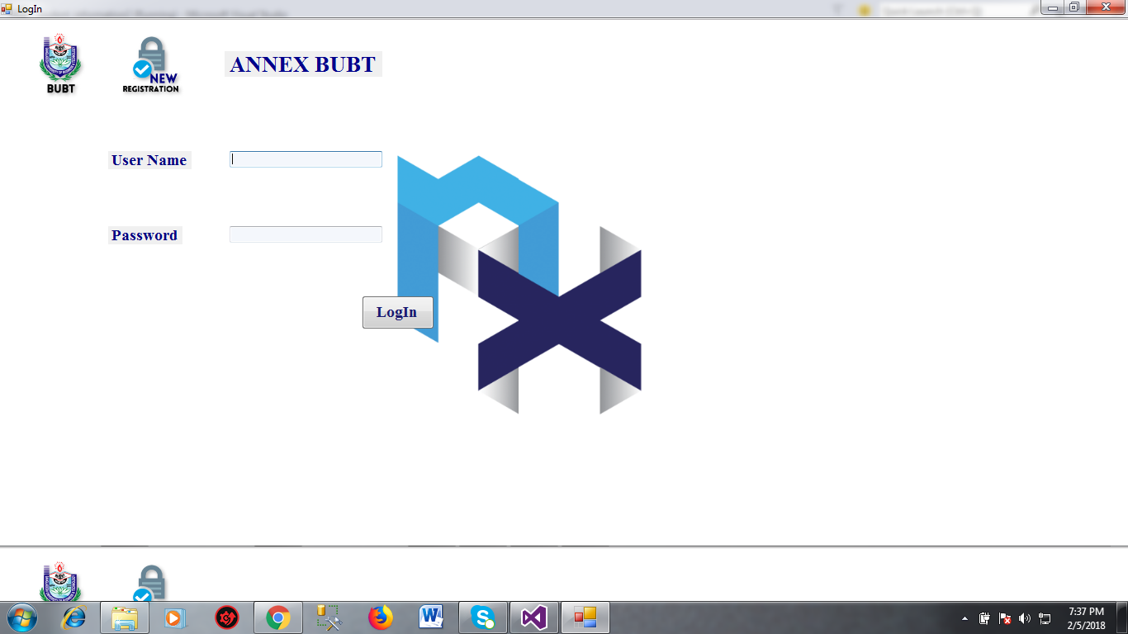

Slide 11
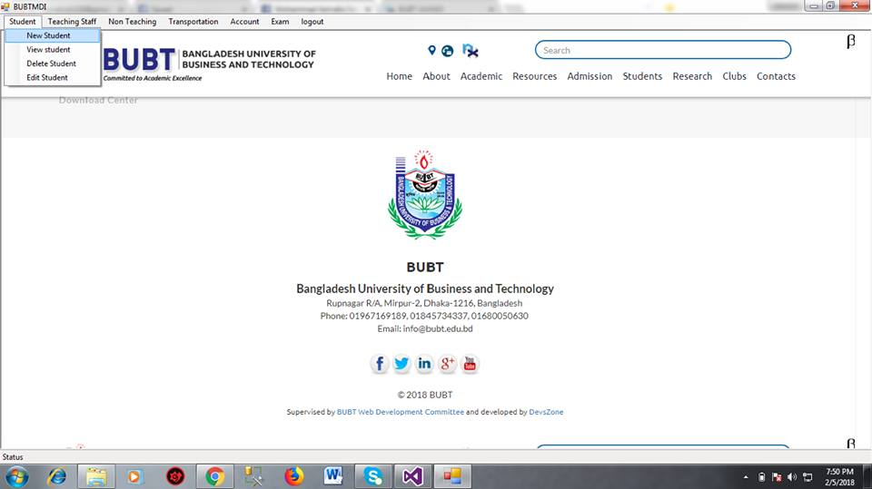

Slide 12
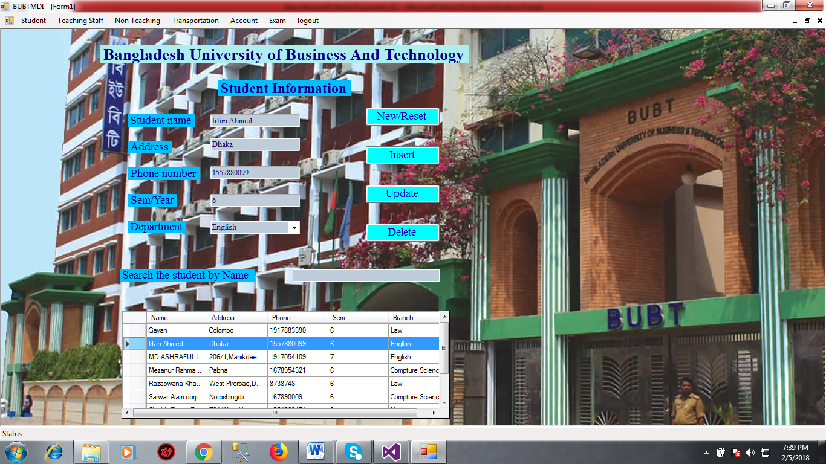

Slide 13
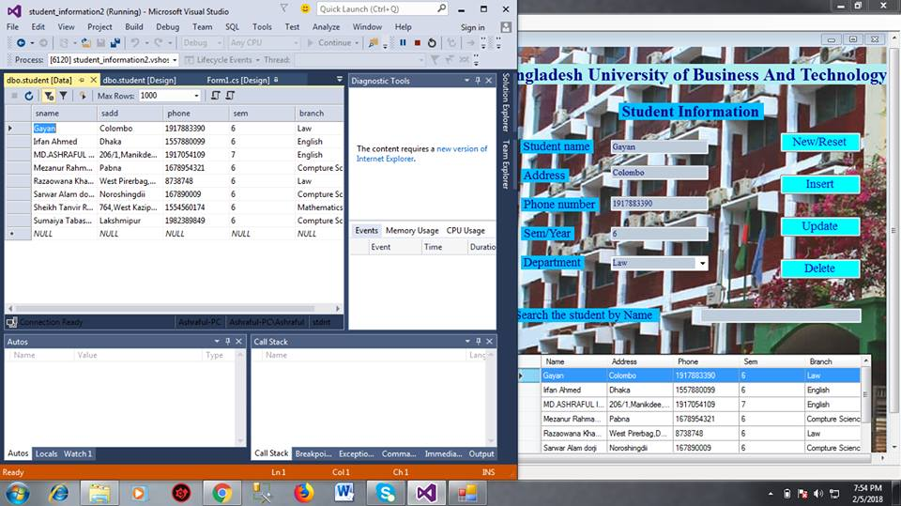

Slide 14
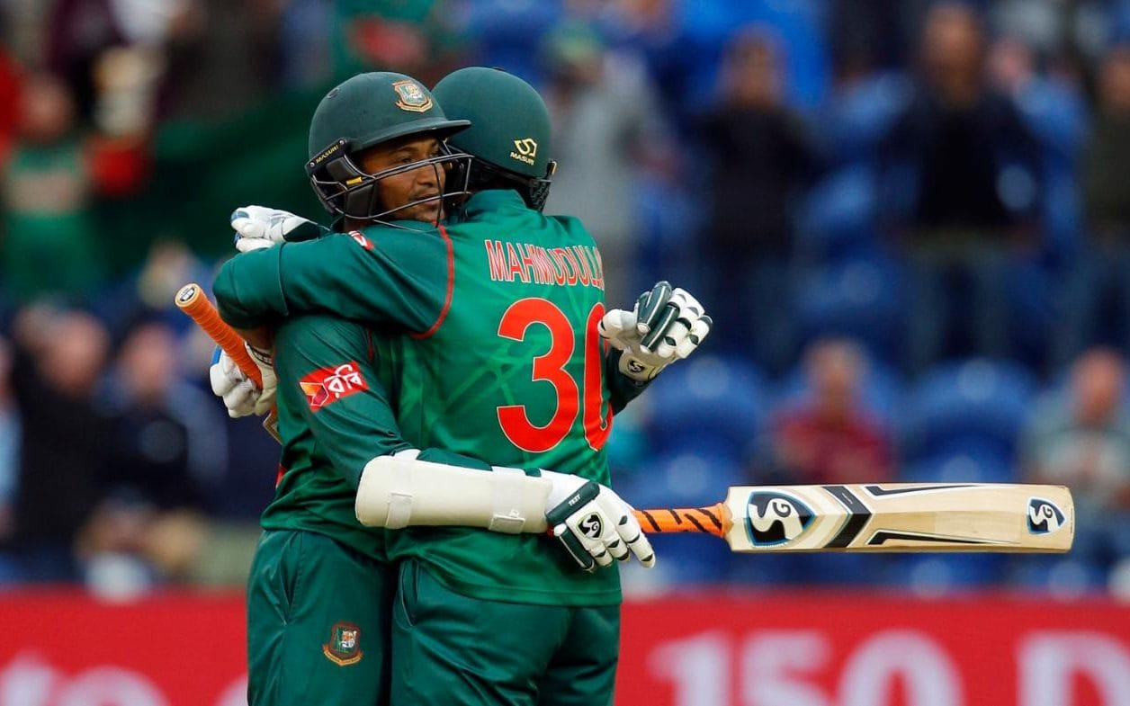
WHEN IT’S COPLETED
IT BRINGS PEACE 😐
THANK YOU 😐
(y)

